Slide 1







Developer Trends Stack Overflow Developer Survey
Robert Caig
12th of April 2024

Slide 2



OUTLINE
Executive Summary
Introduction
Methodology
Results
Visualization – Charts
Dashboard
Discussion
Findings & Implications
Conclusion
Appendix

Slide 3

EXECUTIVE SUMMARY
Analysis goal
Methodology description
Data gathering
Data analysis
Data visualisations
Present results using graphics to indicate trends
Discussion of findings
Final conclusions based on survey results

Slide 4

INTRODUCTION
The data is obtained from Stack Overflow’s annual Developer Survey
Nearly 90,000 respondents from the community
Certain overrepresentation is present in the data
Attempts to identify trends
In current language and technology preferences
Where the industry is moving in the near future

Slide 5

METHODOLOGY
Collect survey data
Data collected from Stack Overflow Developer Survey
Data wrangling
Exploratory data analysis
Data visualisation
Creation of charts and dashboards
Presentation of findings

Slide 6
RESULTS

Slide 7
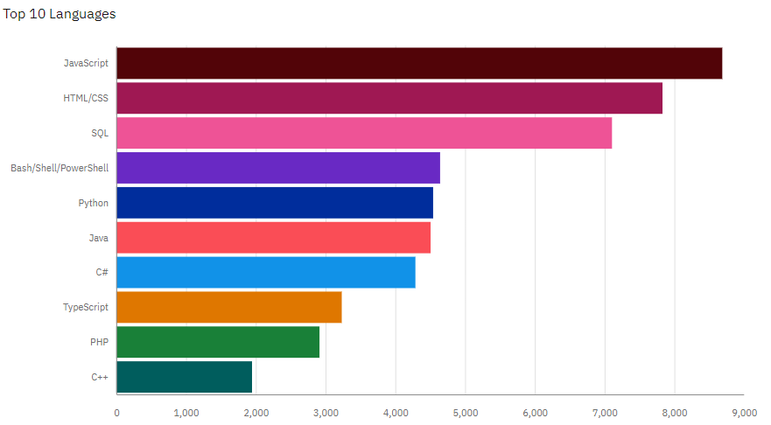
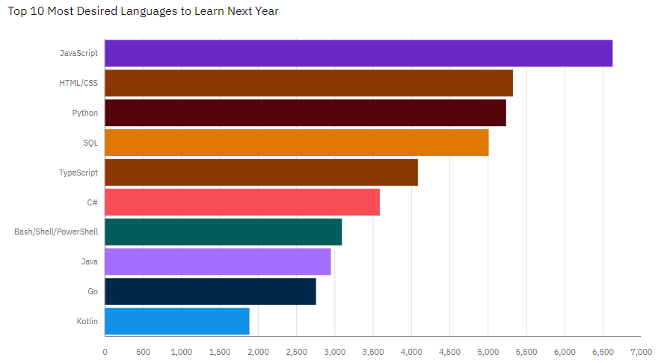
PROGRAMMING LANGUAGE TRENDS
Current Year
Next Year
<Bar chart of top 10 programming languages for the current year goes here.>
< Bar chart of top 10 programming languages for the next year goes here.>

Slide 8
PROGRAMMING LANGUAGE TRENDS - FINDINGS & IMPLICATIONS
Findings
JavaScript and HTML/CSS have market dominance
Interest in Python increasing
SQL may be experiencing a drop in interest
Implications
Languages around data are gaining traction
Reduced interest in historically popular programming languages (C++ / C#)

Slide 9
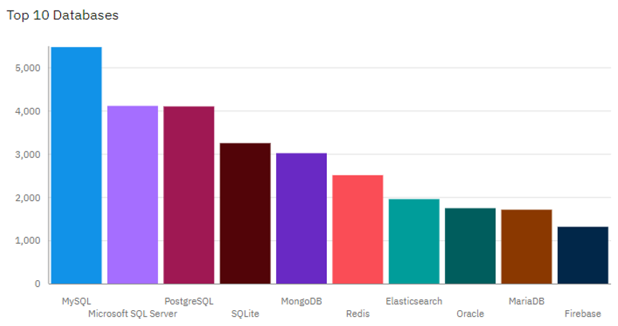
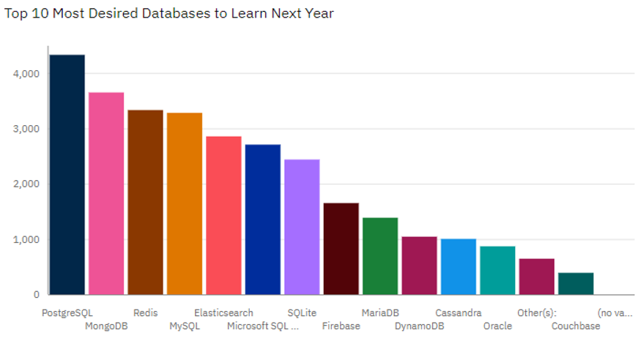
DATABASE TRENDS
Current Year
Next Year
< Bar chart of top 10 databases for the current year goes here >
< Bar chart of top 10 databases for the next year goes here.>

Slide 10
DATABASE TRENDS - FINDINGS & IMPLICATIONS
Findings
MySQL currently the most popular database
Microsoft SQL Server losing traction in the market
Great interest in PostgreSQL and MongoDB
Implications
Potential movement from Microsoft SQL Server and MySQL to PostgreSQL and MongoDB

Slide 11

DASHBOARD
https://github.com/RJCtra/DataAnalysisLearning

Slide 12
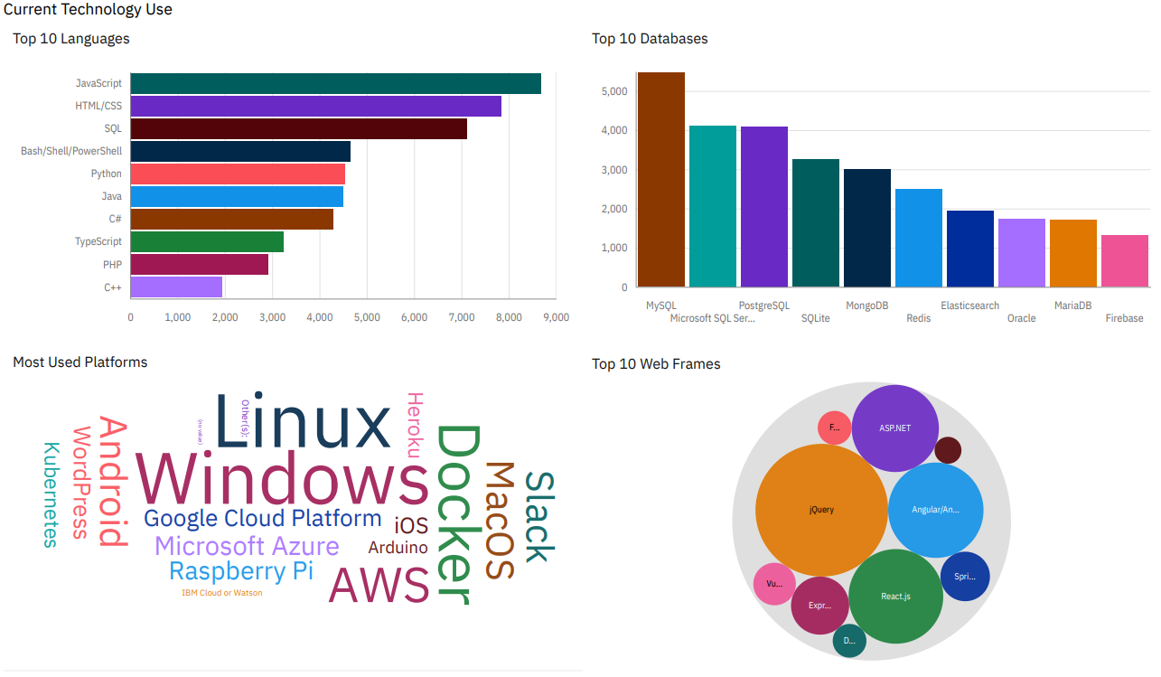
DASHBOARD TAB 1
Screenshot of dashboard tab 1 goes here

Slide 13
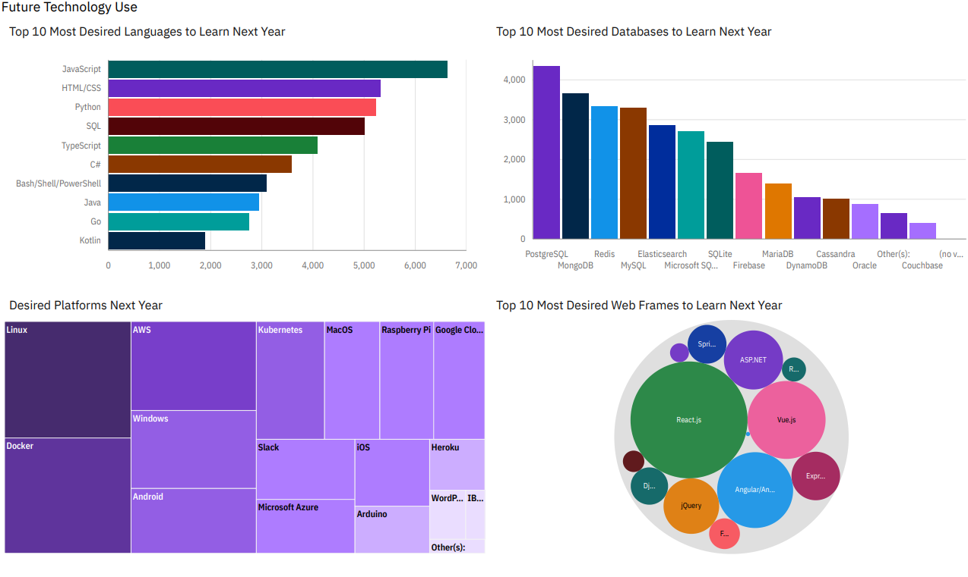
DASHBOARD TAB 2
Screenshot of dashboard tab 2 goes here

Slide 14
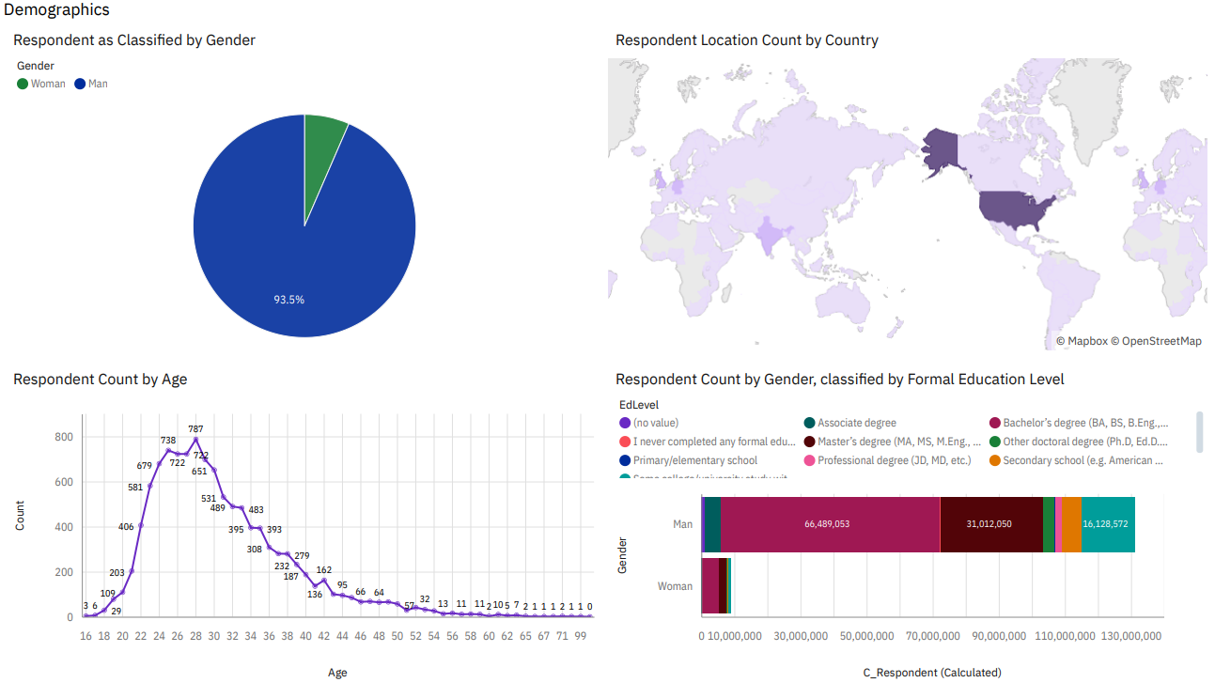
DASHBOARD TAB 3
Screenshot of dashboard tab 3 goes here

Slide 15
DISCUSSION

Slide 16
OVERALL FINDINGS & IMPLICATIONS
Findings
JavaScript is the most widely used language
Majority of respondents are male and between 20-38 years of age
Respondents to survey mostly in United States and other developed nations
Implications
High demand in near future for JavaScript will continue
Highly male dominated field
Relatively low engagement with Stack Overflow outside of the United States

Slide 17

CONCLUSION
There is a great deal of movement within the field with technology and language preferences
Certain languages such as JavaScript, Python, HTML/CSS, and SQL enjoy high adoption
The industry has not attracted great interest from women
Greater engagement with developing countries markets will likely see field growing in near future

Slide 18

APPENDIX
Job Postings
Popular Languages

Slide 19
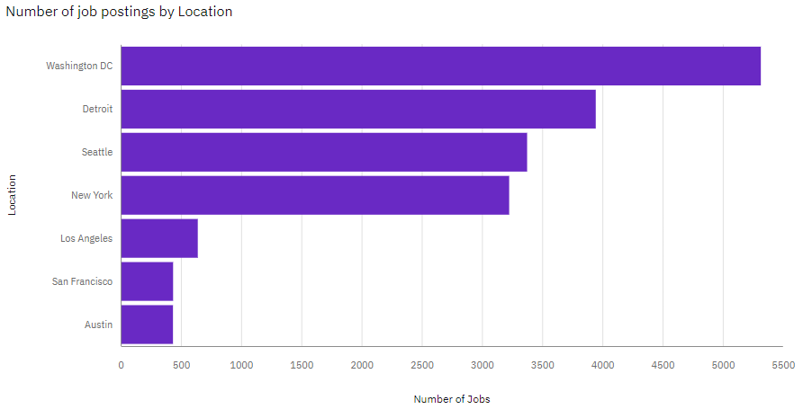
JOB POSTINGS

Slide 20
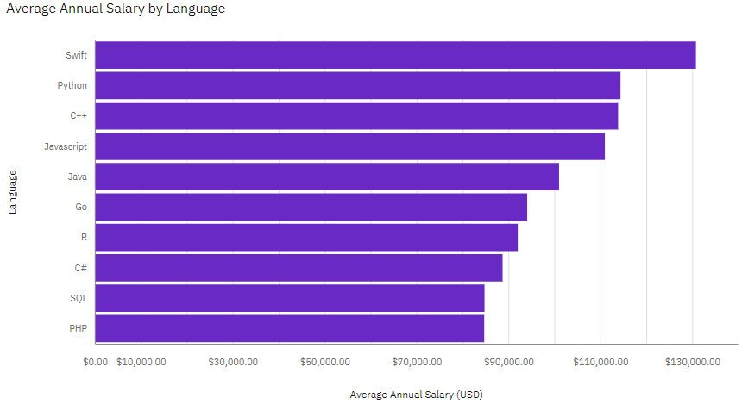
POPULAR LANGUAGES

